Slide 1
Guidelines on Direct & Indirect Receipts
2025
Insert Date, Version, Document Owner, Total Page Number

Slide 2
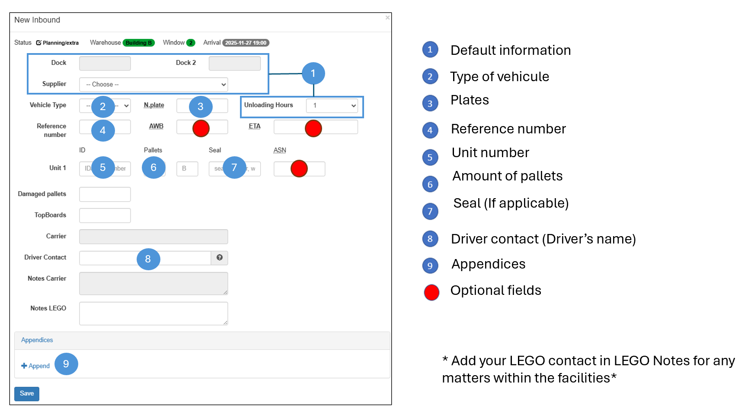


Required fields in WTP
TOLERANCE FOR GETTING TO YOUR APPOINTMENT

Slide 3

General Rules Direct Receipts
WTP General Rules
Appointments can be scheduled at WTP one day before or during the same day with schedule availability.
The required fields must be filled in.
Appointment modification (attach documents, change unit information, etc.) can be made only before the unit registers for surveillance.
The supplier must arrive on time to the appointment, in case they arrive late they will be sent to the line for unloading. 15 min tolerance.
In the event that the unit arrives late for the appointment, LOM will not incur delays, it will be the responsibility of the supplier.
General Rules for Appointments
Only 5 extra appointments are allowed per Building per day = 10 maximum in LOM.
6 am, 6 pm and 11 pm (3 hrs. locked) restricted to scheduling extra appointments.
When there is a 2-hour supplier in unloading time no extra appointments can be scheduled.
All extra appointments must be scheduled within the WTP (Web Transport Planner).
All extra appointments must have the complete information in the WTP (Web Transport Planner).
Extra appointments per type of product/merchandise is equal to 1 to 4 pallets maximum.
All goods/materials that are delivered must be in compliance with Safety and Quality (Transportation).
The request for the Extrabooking by the supplier must be confirmed by mail, adding a copy to the link: @Recibos_LOM (Recibos_LOM@o365.corp.LEGO.com )

Slide 4
General Rules for Indirect Receipts
Reglas Generales para Citas
In the event that the supplier does not have an appointment scheduled at WTP, access to the building will be denied.
In the event that the supplier does not have a badge or scheduled appointment, their materials will not be received.
The required documents must be attached for the receipt of materials (Invoices in PDF format) in the WTP System. E.g. 7000536762-a-116842-alm-ref-moul.pdf (PO - Invoice - End User Name).
The information of the driver, unit and license plates must coincide physically and in WTP, otherwise, access to the building will be denied.
The supplier must arrive 5 mins before the appointment. Please consider the time of entry into security guardhouse.
If supplier is late for the appointment, the supplier will have to wait for availability (there is no approximate time).
In case of showing up early, you will be attended only if there is availability; otherwise, you will have to wait for your scheduled appointment time.
Appointments are scheduled for 15 minutes each and 5 lines will be received per appointment.
The material must be delivered to the building where the appointment was scheduled and that coincides with the invoice, otherwise, the material will be rejected.
The extrabooking must be triggered by the user, not by the supplier. The user is in charge of generating the extrabooking appointment.
In the event of any non-conformity that prevents the generation of the GR to the invoices delivered by the supplier, the material will be rejected and reported as non-conformity.

Slide 5
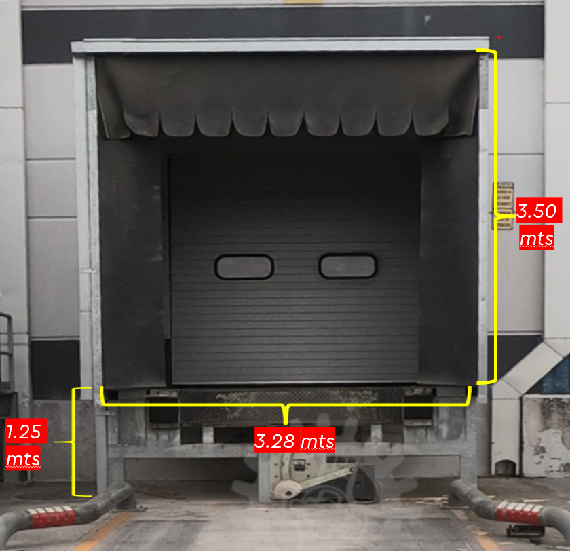
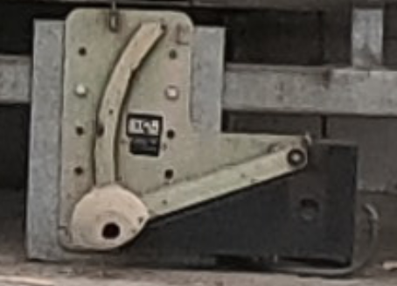

Standard Docks Sizes
2 mts
Note: The hook rises to a height of 77 cm from the ground to its highest point.
40 cms Ancho de Labio
Notes:
Confirmar medidas de rampa

Slide 6
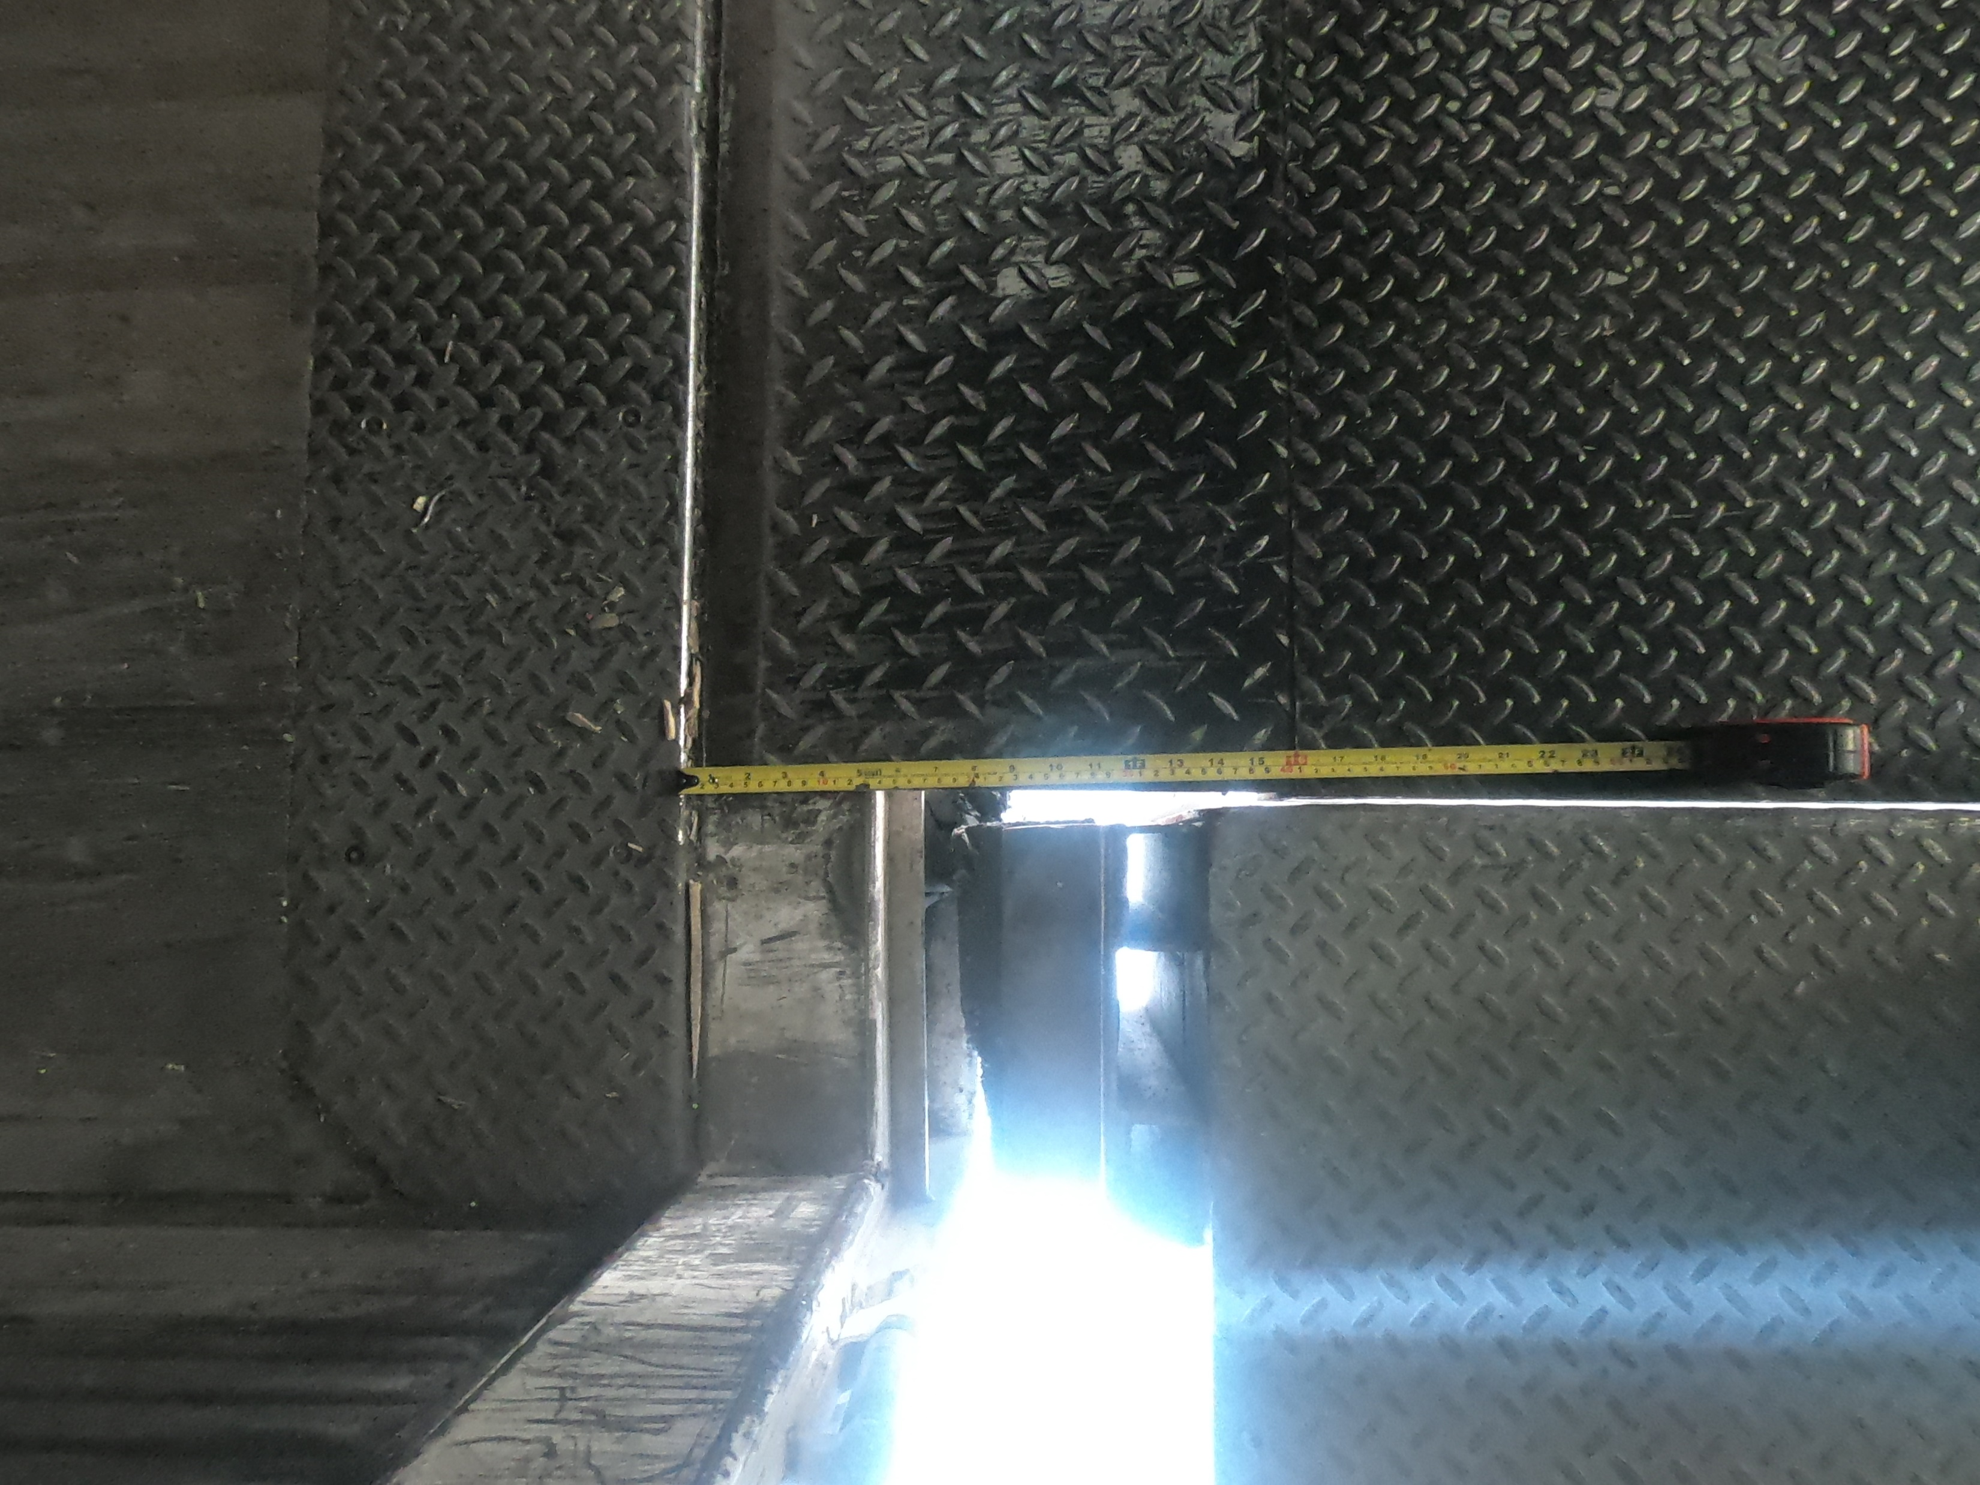
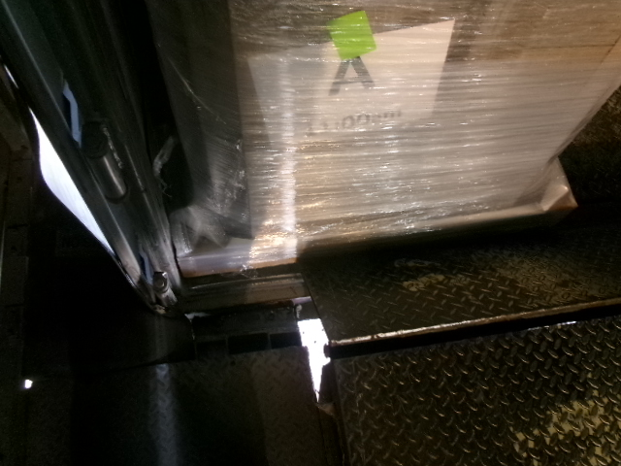



Correct ramp placement
15-20 cm
15 cm
A space of approx. 15 – 20 cm should be left at the end of the trailer/container so that the ramp can be positioned correctly.
The ramp should span 15 cm from the trailer/container.
Pallets located on the edge of the trailer/container prevent the ramp from being placed correctly.
Notes:
Especificar Medidas al interior de la caja
Especificar medidas del labio al colocarse en la caja

Slide 7
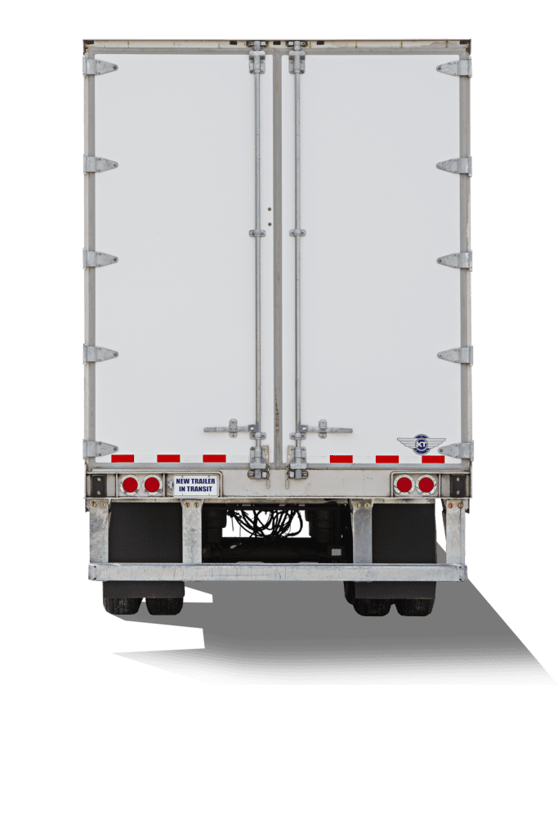
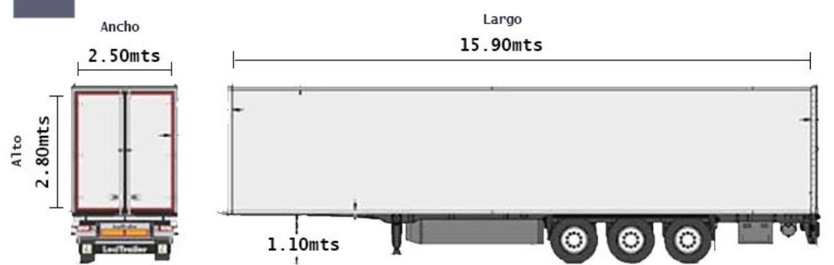

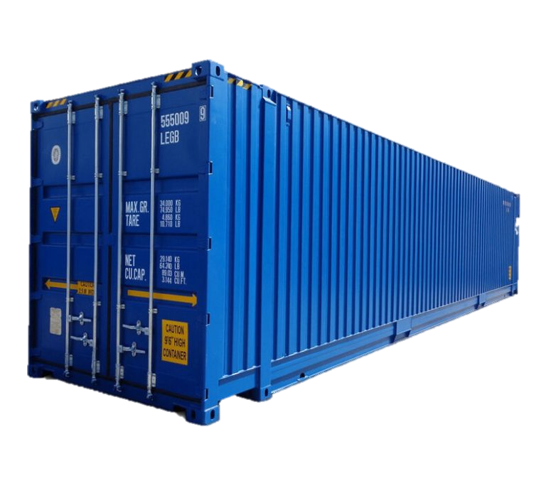
Trailer and Containers Specifications
Heights for unloadings
Min Height 1.25
Max Height 1.35 mts
Units Designed for forklift entry.
Example:
53”
Dual Axle Units
Rabon 10 Ton
1.35 mts max (Floor to Trailer Int)
1 m
45 to 55 cms
Notes:
Confirmar medidas de base de caja al piso

Slide 8
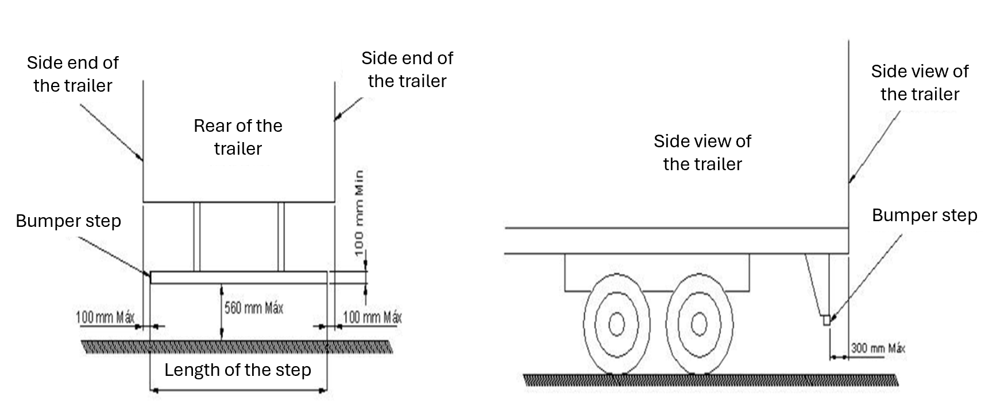
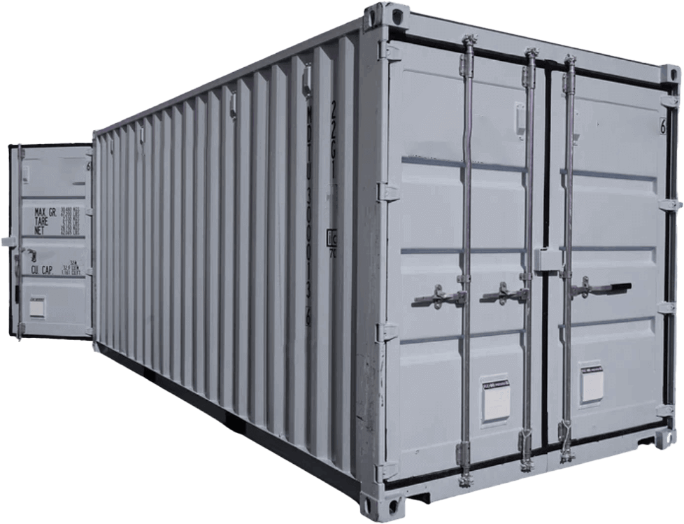

Trailer and Containers Specifications
Note: It has been identified that the damage caused to ramp hooks has been generated with abutments that are not aligned to the end of the trailer/container.

Slide 9
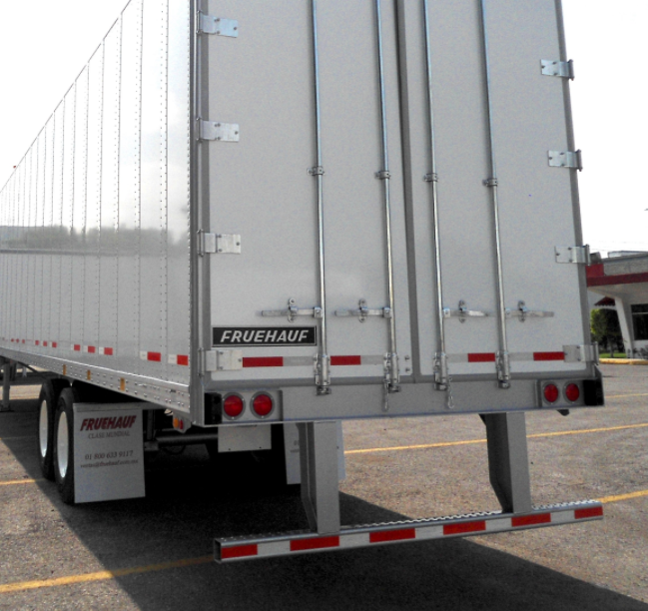
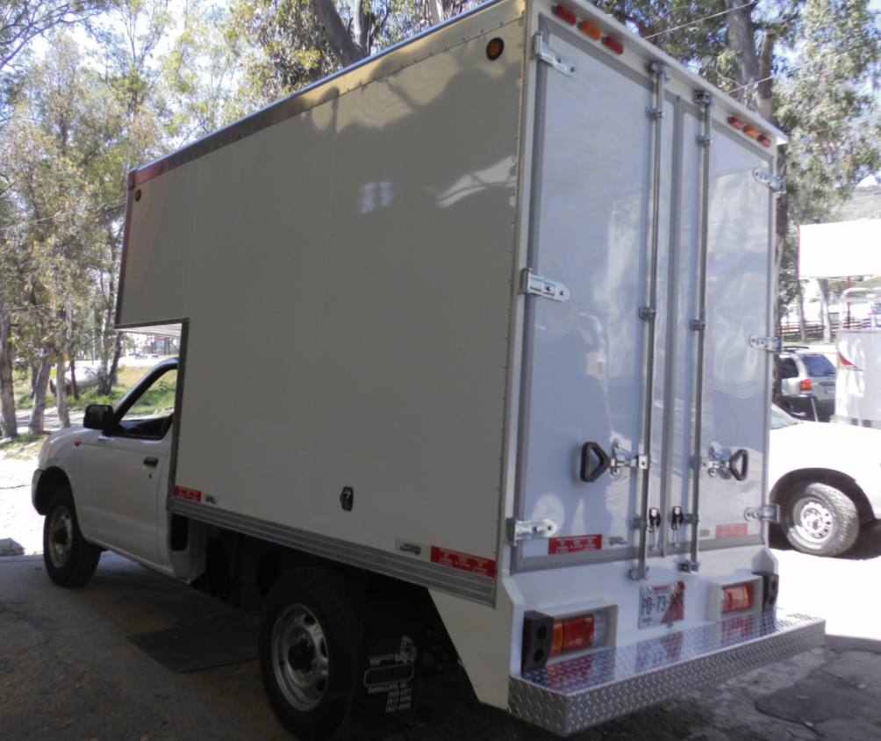
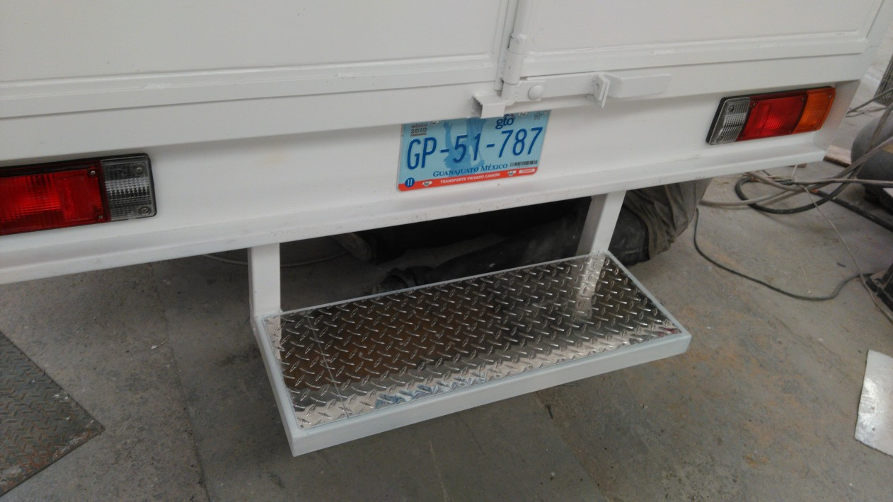
Examples of rear truck bumper guard

Slide 10
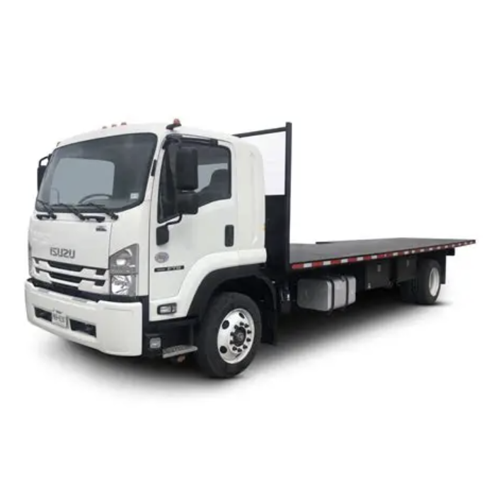

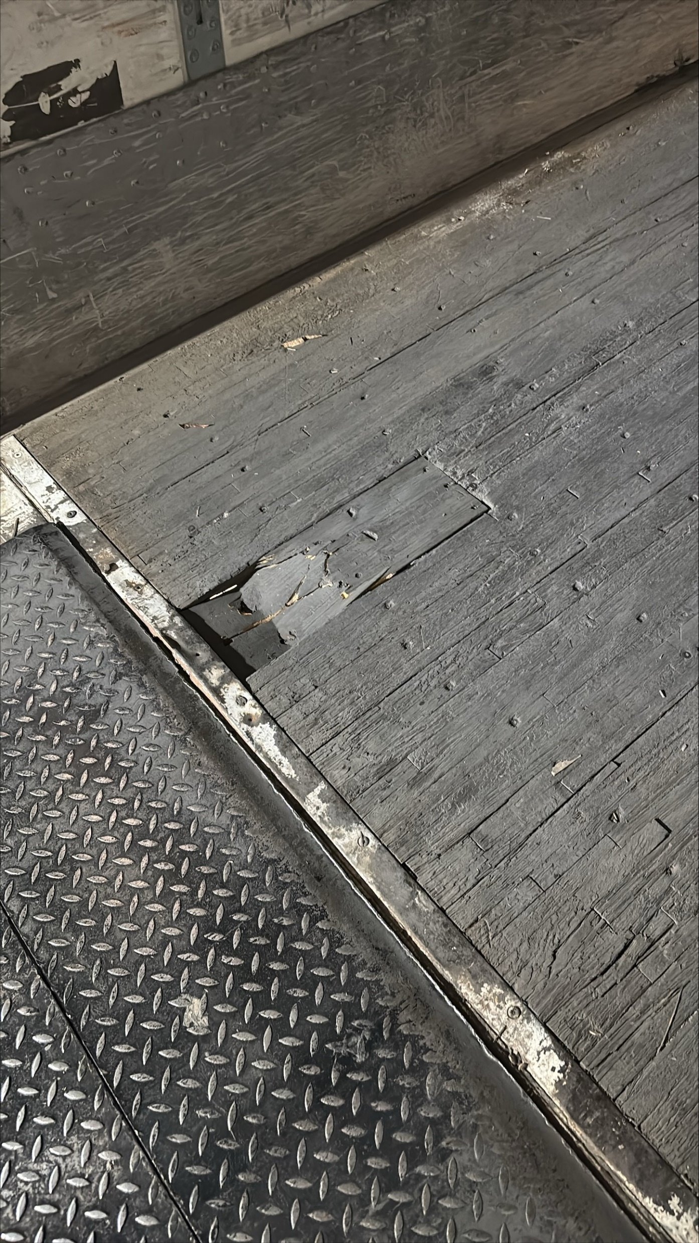
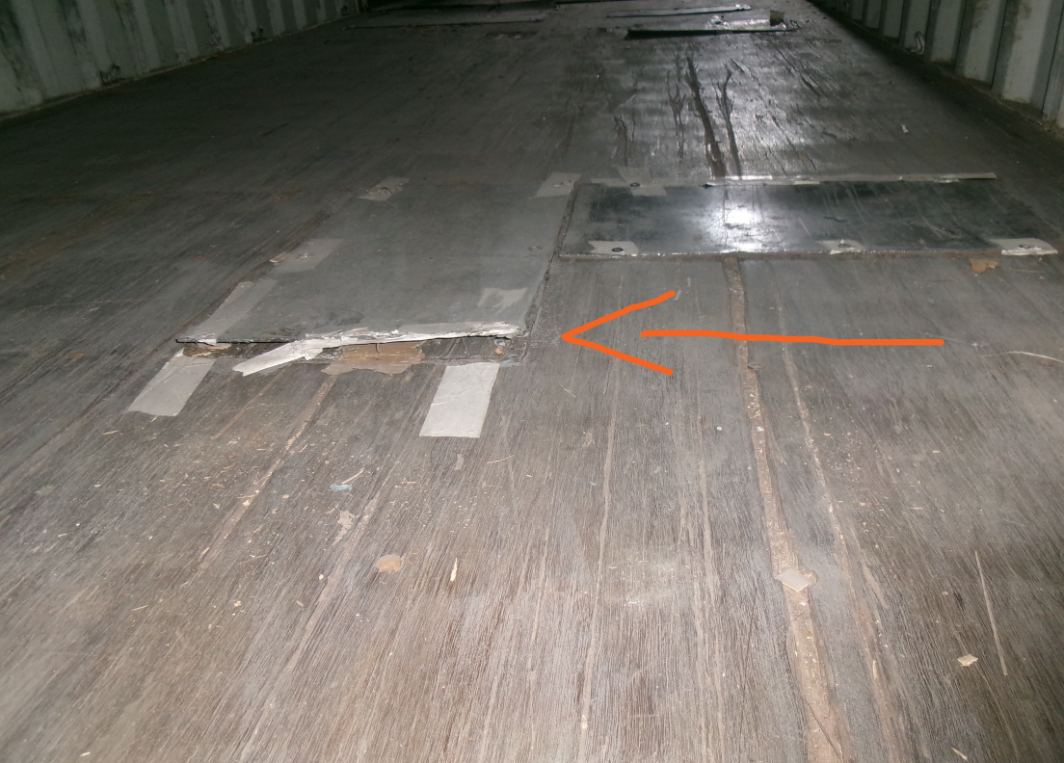
Unsuitable Units
Torton
1 axis units
Rabon (less than 10 Ton)
Trailers/containers with Floor Patches
Trailers/containers with damaged floors
For ramp unloading, units that support the weight of the forklift are required

Slide 11
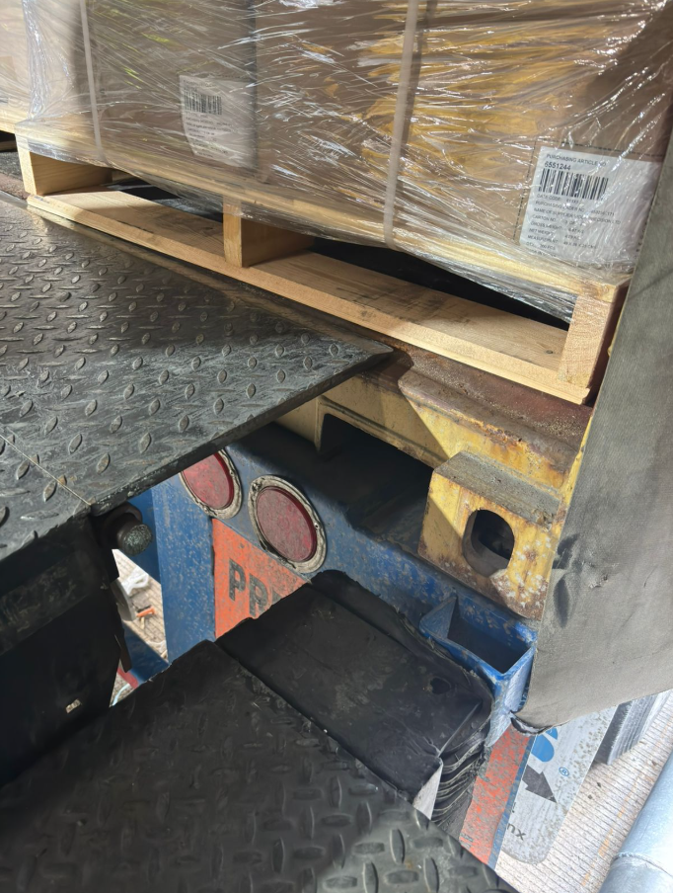

Specifications Import Units
The chassis must have airbags.
The chassis must have air valves.
The rear truck bumper guard must be in good condition.
The units must have tires in good condition.
25 cm
Example of rejected unit

Slide 12
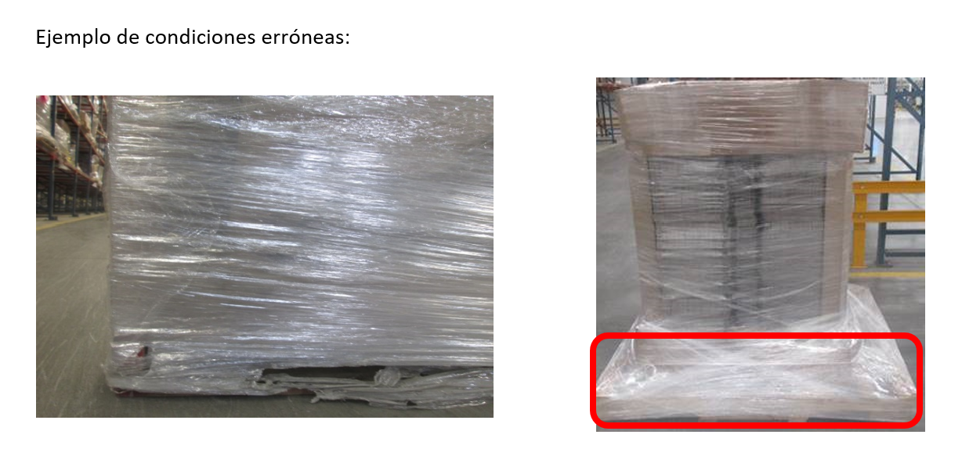

Material Conditions
The conditions of the materials for receipt must be as follows:
Pallets in good condition
Wrapping paper without covering holes in the pallet
The max. height is considering the pallet
Dimensions including pallet:
Height: 1.10 mts máx for local direct materials / Import
Height : 1.15 mts máx for Call Off Materials
Weight: 700 kgs máx.

Slide 13
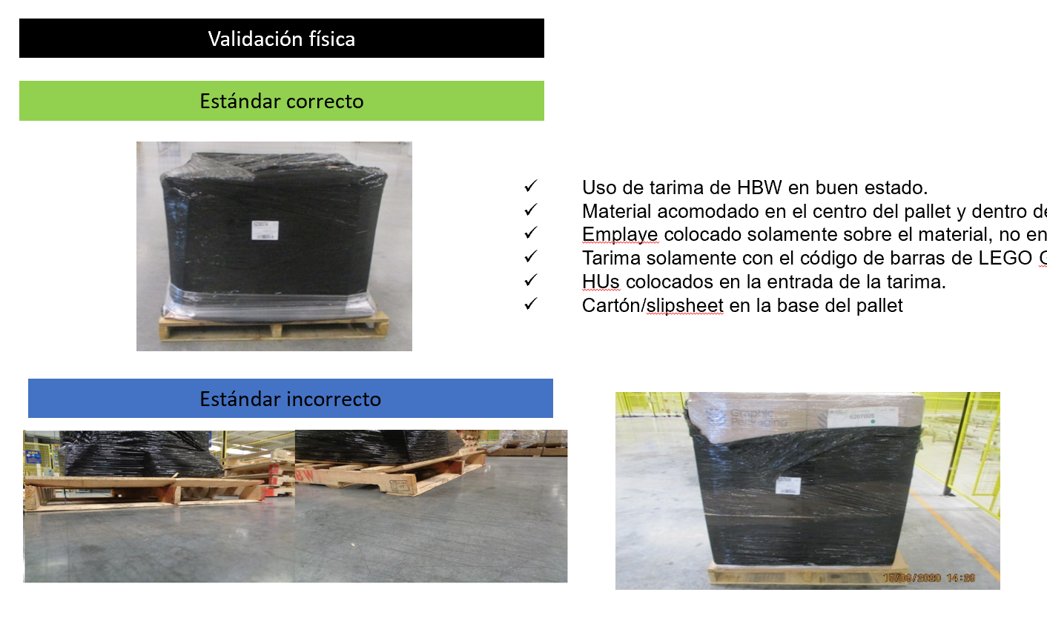

Call OFF Standard
Physical Validation
Correct Standard
Use of HBW pallet in good condition.
Material accommodated in the center of the pallet and within the dimensions.
Wrapping paper placed only on the material, not on the pallet.
Pallet with LEGO Group barcode only(HU/Boxticket).
HUs placed at the entrance of the pallet.
Cardboard/slipsheet at the base of the pallet.
Incorrect Standard

Slide 14
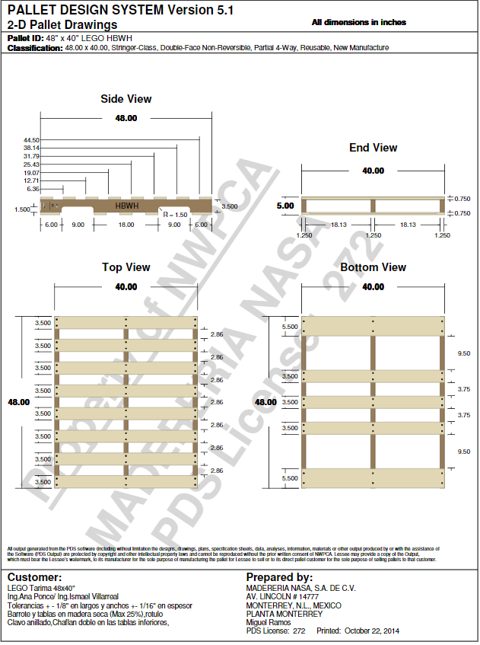
Call OFF Standard
The pallet must be 48x 40 HBW model according to the attached specifications.
Supplier identification sheets should be located in the 48-inch zone.

Slide 15
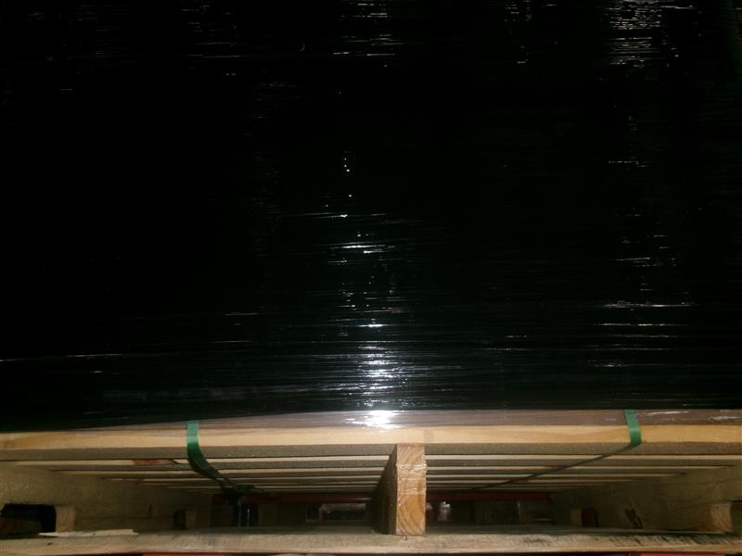
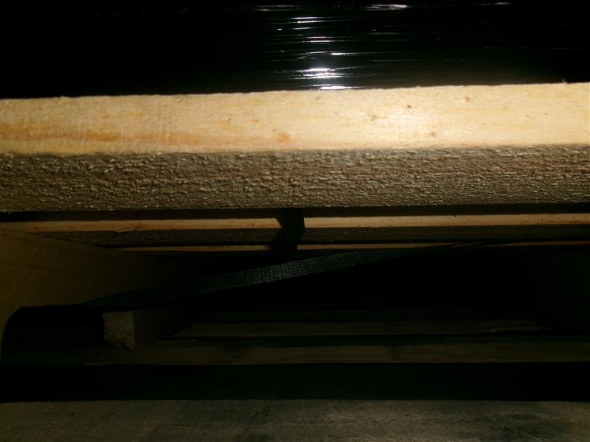
Placement of Strapping in Material – Call off
Placing the strap vertically generates deformations on the pallet.
Placing the strap horizontally, embracing the material is the correct way to avoid deformations on the pallet.

